Slide 1
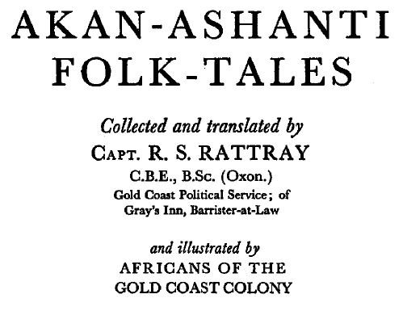
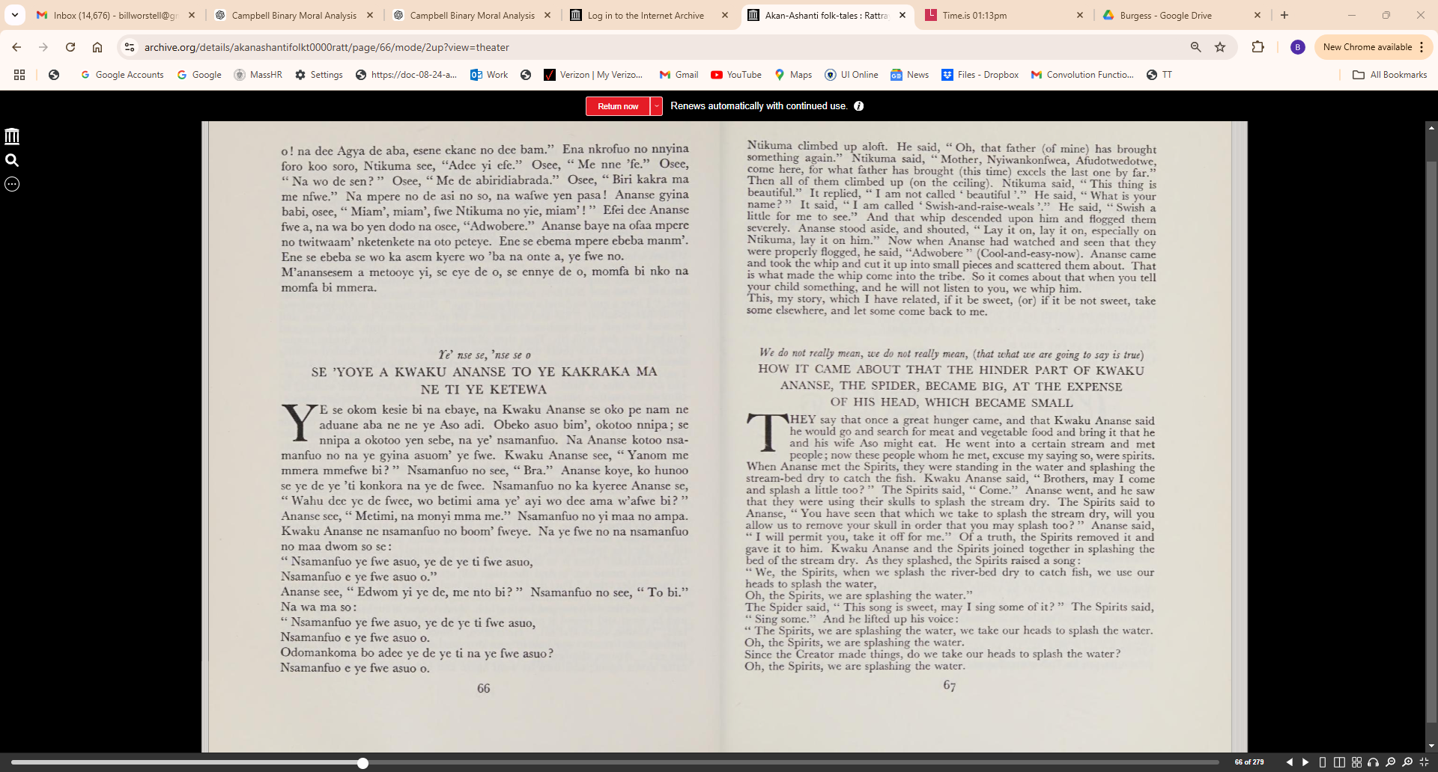

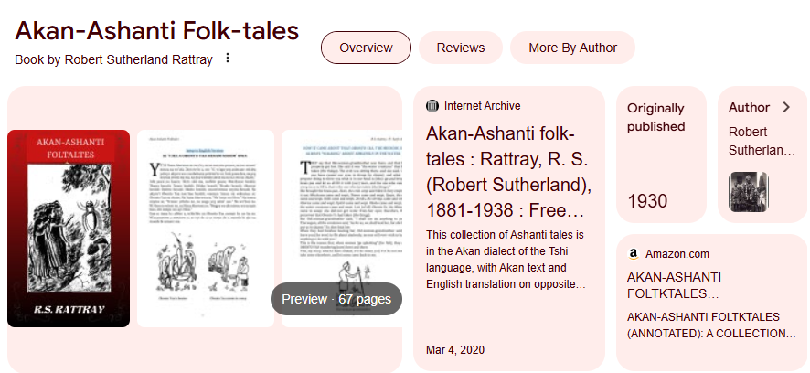
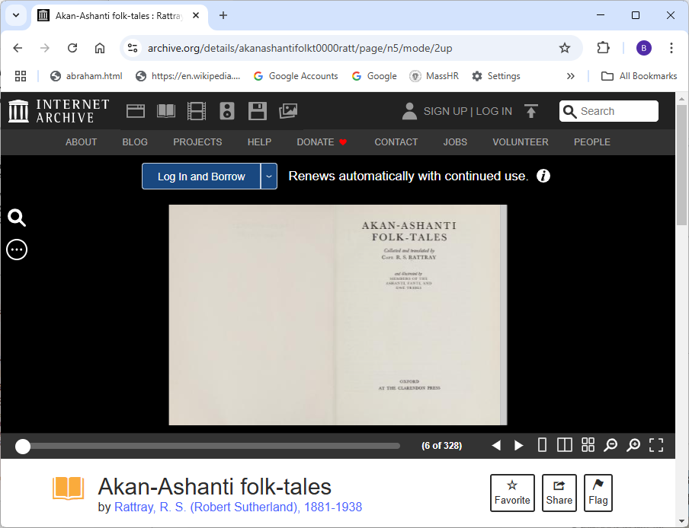
Demo Source Material:
https://archive.org/details/akanashantifolkt0000ratt/page/n5/mode/2up

Slide 2
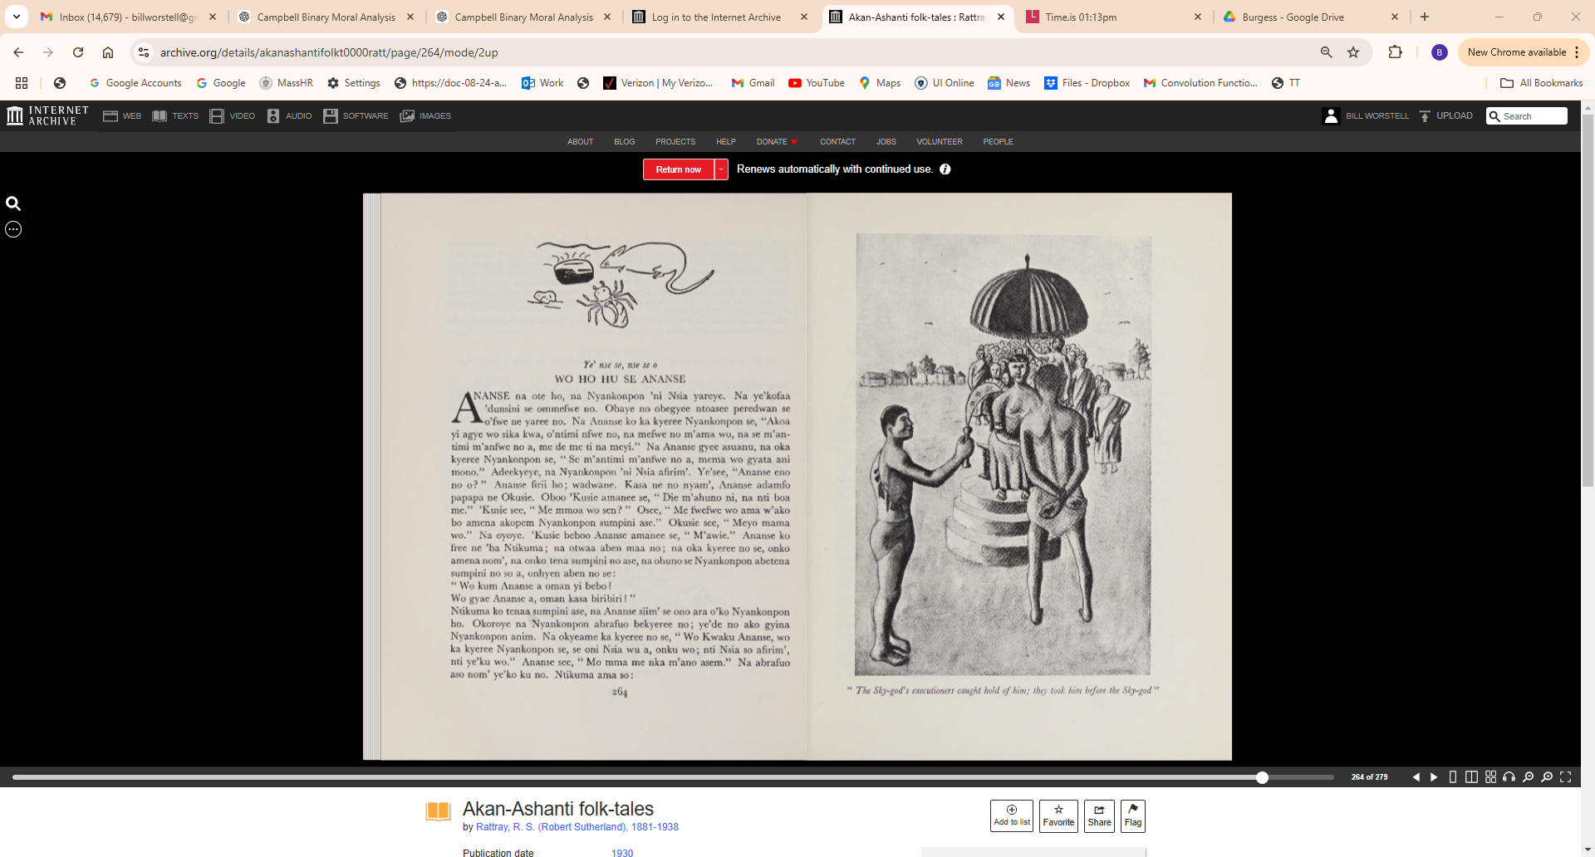

Slide 3
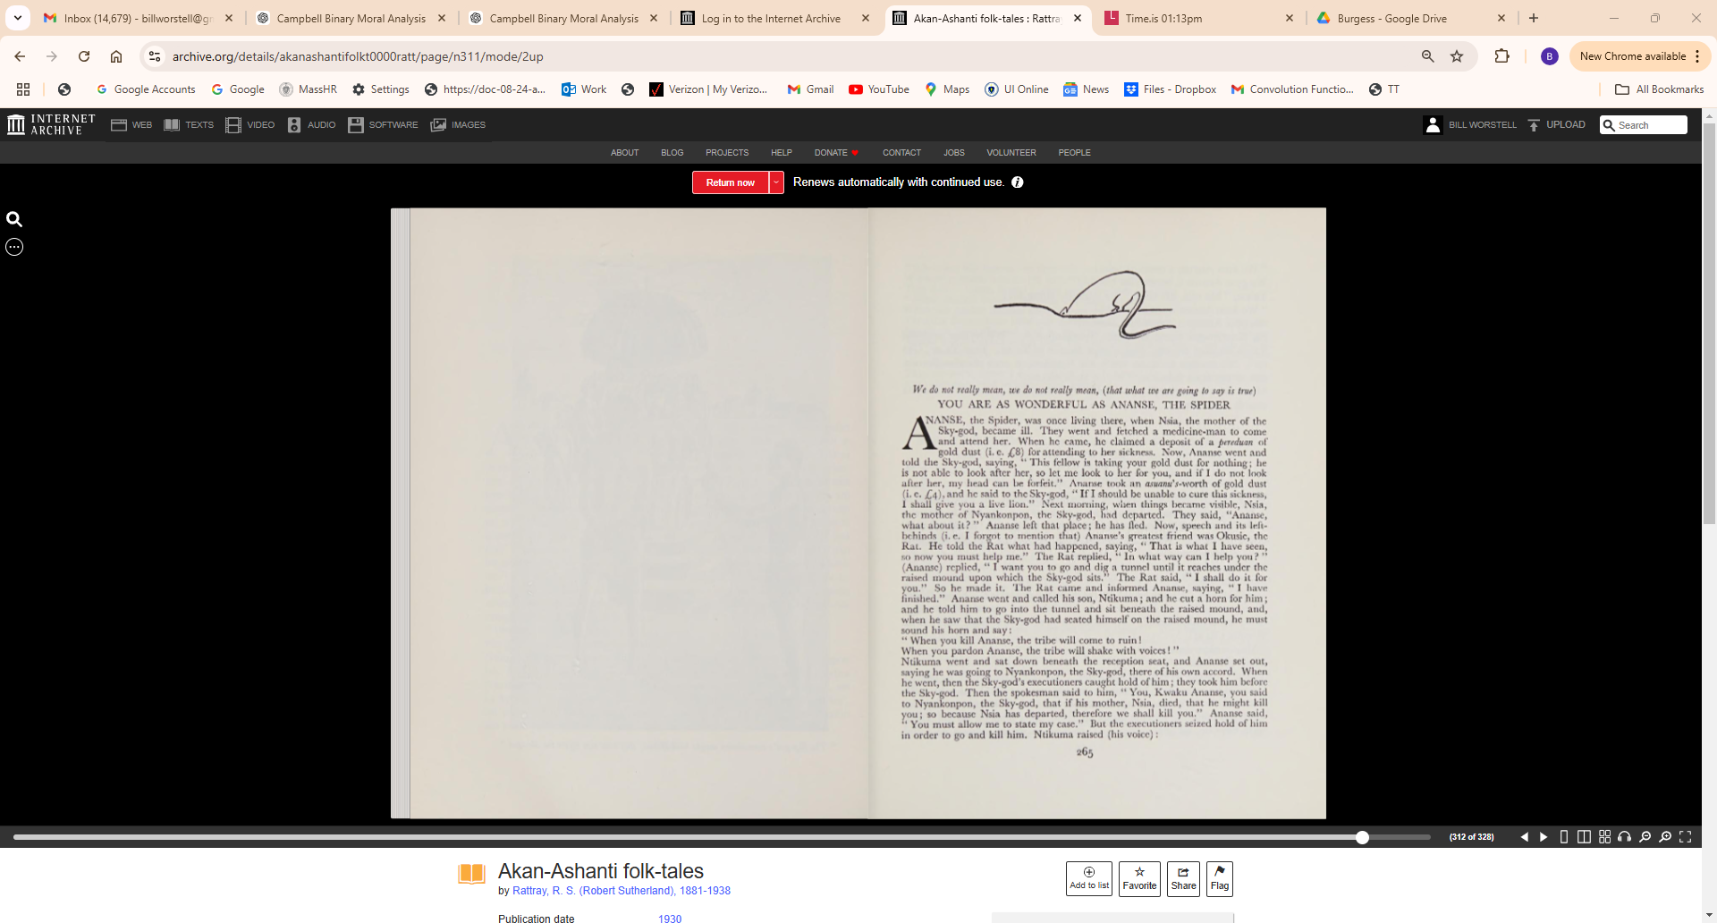

Slide 4
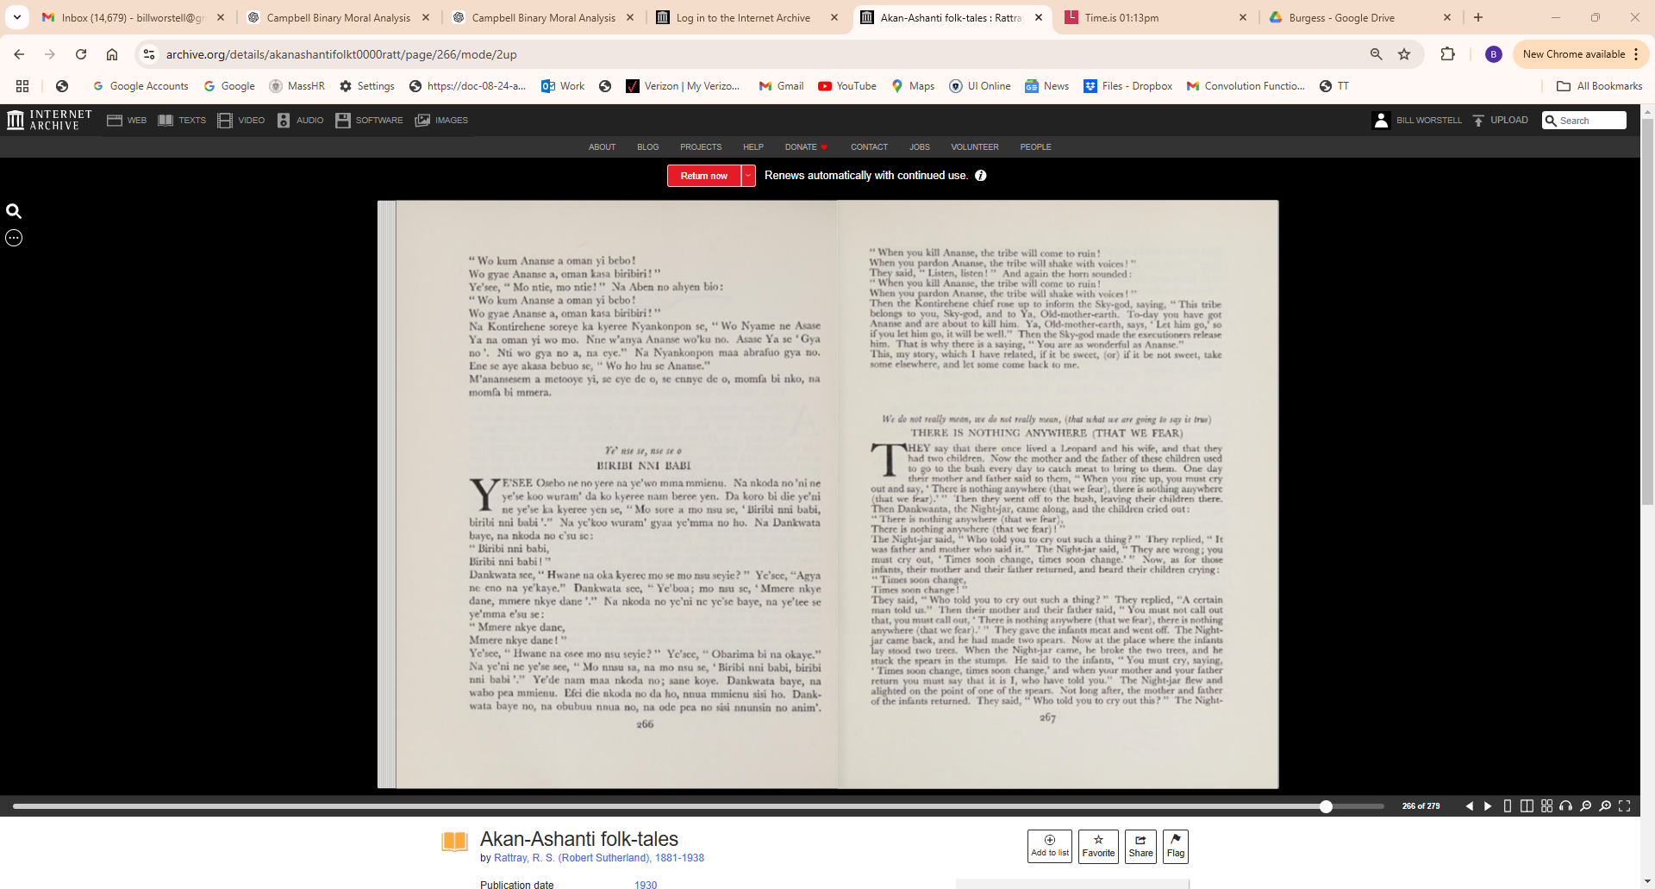

Slide 5
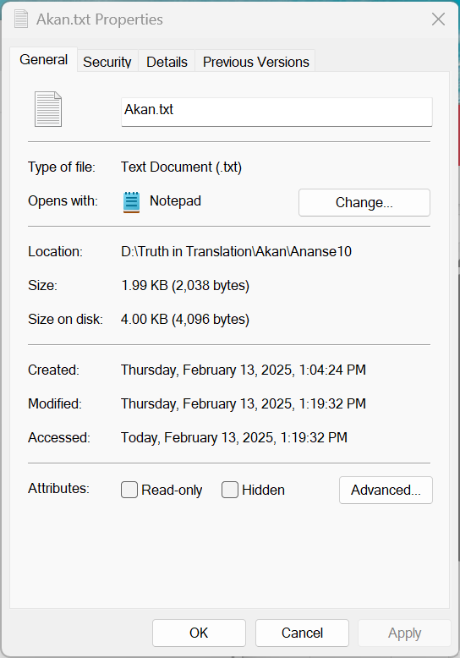
Ye' nse se, nse se o
WO HO HU SE ANANSE
ANANSE na ote ho, na Nyankonpon 'ni Nsia yareye. Na ye'kofaa
l Idunsini se ommefwe no. Obaye no obegyee ntoasee peredwan se
o'fwe ne yarce no. Na Ananse ko ka kyerec Nyankonpon se, "Akoa
yi agye wo sika kwa, o'ntimi nfwe no, na mefwe no m'ama wo, na se m'an
timi m'anfwe no a, me de me ti na meyi." Na Ananse gyee asuanu, na oka
kyerce Nyankonpon se, " Se m'antimi m'anfwe no a, mema wo gyata ani
mono." Adeekyeye, na Nyankonpon 'ni Nsia afirim'. Ye'see, "Ananse eno
no o? " Ananse firii ho; wadwane. Kasa ne no nyam', Ananse adamfo
papapa ne Okusie. Oboo 'Kusie amance se, " Die m'ahuno ni, na nti boa
me." 'Kusie see, " Me mmoa wo sen? " Oseey " Me fWefwe wo ama w'ako
bo amena akopem Nyankonpon sumpini ase." Okusie sec, " Meyo mama
wo." Na oyoye. 'Kusie beboo Ananse amanee se, " M'awie.'-' Ananse ko
free ne 'ba Ntikuma; na otwaa aben maa no; na oka kyeree no se, onko
amena nomy , na onko tena sumpini no ase, na ohuno se Nyankonpon abetena
sumpini no so a, onhyen aben no se:
" Wo kum Ananse a oman yi bebo!
Wo gyae Ananse a, oman kasa biribiri!
Ntikuma ko tenaa sumpini ase, na Ananse siim' se ono ara o'ko Nyankonpon
ho. Okoroye na Nyankonpon abrafuo bekyeree no; ye'de no ako gyina
Nyankonpon anim. Na okyeame ka kyerec no se, " Wo Kwaku Ananse, wo
ka kyeree Nyankonpon se, se oni Nsia wu a, onku wo; nti Nsia so afirim',
nti ye'ku wo." Ananse see, " Mo mma me nka m'ano asem." Na abrafuo
aso nomt ye'ko ku no. Ntikuma ama so:
" Wo kum Ananse a oman yi bebo!
Wo gyae Ananse a, oman kasa biribiri!"
Ye'see, " Mo ntie, mo ntie! " Na Aben no ahyen bio:
"Wo kum Ananse a oman yi bebo !
Wo gyae Ananse a, oman kasa biribiri!"
Na Kontirehene soreye ka kyeree Nyankonpon se, "Wo Nyame ne Asase
Ya na oman yi wo mo. Nne w'anya Ananse wo'ku no. Asase Ya se 'Gya
no'. Nti wo gya no a, na eye." Na Nyankonpon maa abrafuo gya no.
Ene se aye akasa bebuo se, "Wo ho hu se Ananse."
M'anansesem a metooye yi, se eye de o, se ennye de o, momfa bi nko, na
momfa bi mmera.

Slide 6
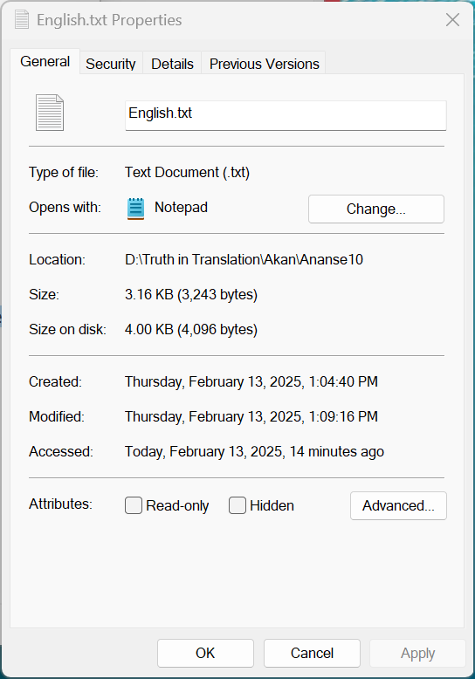
We do not really mean, we do not really mean, (that what we are going to say is true)
YOU ARE AS WONDERFUL AS ANANSE, THE SPIDER
ANANSE, the Spider, was once living there, when Nsia, the mother of the
Sky-god, became ill. They went and fetched a medicine-man to come
and attend her. When he came, he claimed a deposit of a pereduan of
gold dust (i. e. £8) for attending to her sickness. Now, Ananse went and
told the Sky-god, saying, " This fellow is taking your gold dust for nothing; he
is not able to look after her, so let me look to her for you, and if I do not look
after her, my head can be forfeit." Ananse took an asuanu's-worth of gold dust
(i. e. £4), and he said to the Sky-god, "If I should be unable to cure this sickness,
I shall give you a live lion." Next morning, when things became visible, Nsia,
the mother of Nyankonpon, the Sky-god, had departed. They said, "Ananse,
what about it? " Ananse left that place; he has fled. Now, speech and its left
behinds (i. e. I forgot to mention that) Ananse's greatest friend was Okusie, the
Rat. He told the Rat what had happened, saying, "That is what I have seen,
so now you must help me." The Rat replied, " In what way can I help you? "
(Ananse) replied, " I want you to go and dig a tunnel until it reaches under the
raised mound upon which the Sky-god sits." The Rat said, "I shall do it for
you." So he made it. The Rat came and informed Ananse, saying, "I have
finished." Ananse went and called his son, Ntikuma; and he cut a horn for him;
and he told him to go into the tunnel and sit beneath the raised mound, and,
when he saw that the Sky-god had seated himself on the raised mound, he must
sound his horn and say:
"When you kill Ananse, the tribe will come to ruin!
When you pardon Ananse, the tribe will shake with voices!"
Ntikuma went and sat down beneath the reception seat, and Ananse set out,
saying he was going to Nyankonpon, the Sky-god, there of his own accord. When
he went, then the Sky-god's executioners caught hold of him; they took him before
the Sky-god. Then the spokesman said to him, " You, Kwaku Ananse, you said
to Nyankonpon, the Sky-god, that if his mother, Nsia, died, that he might kill
you; so because Nsia has departed, therefore we shall kill you." Ananse said,
"You must allow me to state my case." But the executioners seized hold of him
in order to go and kill him. Ntikuma raised (his voice): "When you kill Ananse, the tribe will come to ruin!
When you pardon Ananse, the tribe will shake with voices!"
They said, " Listen, listen! " And again the horn sounded:
" When you kill Ananse, the tribe will come to ruin!
When you pardon Ananse, the tribe will shake with voices!"
Then the Kontirehene chief rose up to inform the Sky-god, saying, " This tribe
belongs to you, Sky-god, and to Ya, Old-mother-earth. To-day you have got
Ananse and are about to kill him. Ya, Old-mother-earth, says, 'Let him go,' so
if you let him go, it will be well." Then the Sky-god made the executioners release
him. That is why there is a saying, " You are as' wonderful as Ananse."
This, my story, which I have related, if it be sweet, (or) if it be not sweet, take
some elsewhere, and let some come back to me.

Slide 7
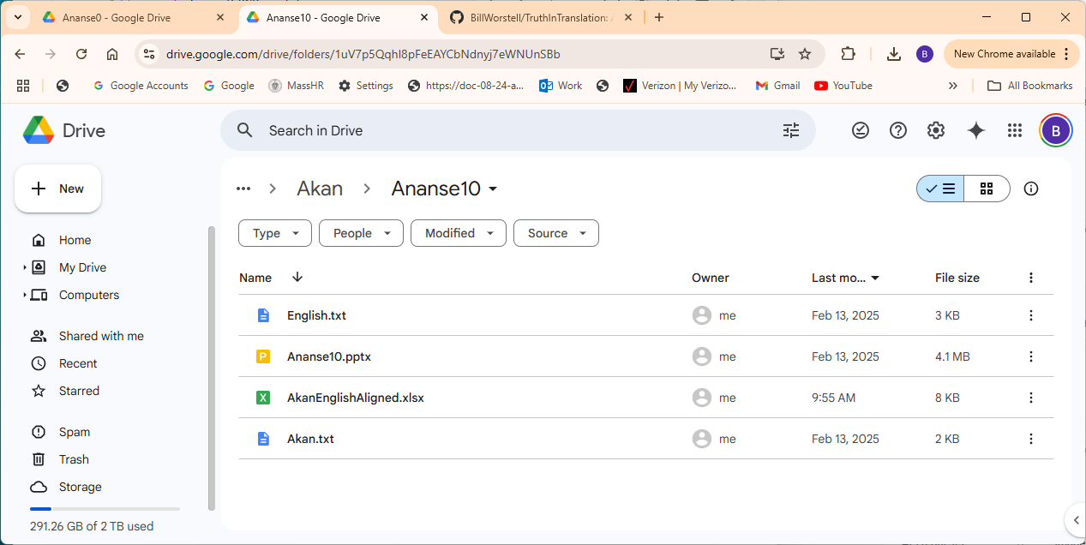
----- GPT-3.5-turbo Estimate ----- Prompt tokens: 1890 Completion tokens (est): 200 Approx total tokens: 2090 Prompt cost: $0.0028 Completion cost: $0.0004 Total cost (est): $0.0032 ----- GPT-4 Estimate ----- Prompt tokens: 1890 Completion tokens (est): 200 Approx total tokens: 2090 Prompt cost: $0.0567 Completion cost: $0.0120 Total cost (est): $0.0687 Number of aligned sentence pairs: 26
----- GPT-3.5-turbo Estimate -----
Prompt tokens: 1890
Completion tokens (est): 200
Approx total tokens: 2090
Prompt cost: $0.0028
Completion cost: $0.0004
Total cost (est): $0.0032
----- GPT-4 Estimate -----
Prompt tokens: 1890
Completion tokens (est): 200
Approx total tokens: 2090
Prompt cost: $0.0567
Completion cost: $0.0120
Total cost (est): $0.0687
Number of aligned sentence pairs: 26

Slide 8
AKAN | ENGLISH
Ye' nse se, nse se o | We do not really mean, we do not really mean, (that what we are going to say is true)
WO HO HU SE ANANSE | YOU ARE AS WONDERFUL AS ANANSE, THE SPIDER
ANANSE na ote ho, na Nyankonpon 'ni Nsia yareye. | ANANSE, the Spider, was once living there, when Nsia, the mother of the Sky-god, became ill.
Na ye'kofaa l Idunsini se ommefwe no. | They went and fetched a medicine-man to come and attend her.
Obaye no obegyee ntoasee peredwan se o'fwe ne yarce no. | When he came, he claimed a deposit of a pereduan of gold dust (i. e. £8) for attending to her sickness.
Na Ananse ko ka kyerec Nyankonpon se, "Akoa yi agye wo sika kwa, o'ntimi nfwe no, na mefwe no m'ama wo, na se m'an timi m'anfwe no a, me de me ti na meyi." | Now, Ananse went and told the Sky-god, saying, " This fellow is taking your gold dust for nothing; he is not able to look after her, so let me look to her for you, and if I do not look after her, my head can be forfeit."
Na Ananse gyee asuanu, na oka kyerce Nyankonpon se, " Se m'antimi m'anfwe no a, mema wo gyata ani mono." | Ananse took an asuanu's-worth of gold dust (i. e. £4), and he said to the Sky-god, "If I should be unable to cure this sickness, I shall give you a live lion."
Adeekyeye, na Nyankonpon 'ni Nsia afirim'. | Next morning, when things became visible, Nsia, the mother of Nyankonpon, the Sky-god, had departed.
Ye'see, "Ananse eno no o? " Ananse firii ho; wadwane. | They said, "Ananse, what about it? " Ananse left that place; he has fled.
Kasa ne no nyam', Ananse adamfo papapa ne Okusie. | Now, speech and its left behinds (i. e. I forgot to mention that) Ananse's greatest friend was Okusie, the Rat.
Oboo 'Kusie amance se, " Die m'ahuno ni, na nti boa me." | He told the Rat what had happened, saying, "That is what I have seen, so now you must help me."
'Kusie see, " Me mmoa wo sen? " Oseey " Me fWefwe wo ama w'ako bo amena akopem Nyankonpon sumpini ase." | The Rat replied, " In what way can I help you? " (Ananse) replied, " I want you to go and dig a tunnel until it reaches under the raised mound upon which the Sky-god sits."
Okusie sec, " Meyo mama wo." | The Rat said, "I shall do it for you."
Na oyoye. 'Kusie beboo Ananse amanee se, " M'awie.'-' Ananse ko free ne 'ba Ntikuma; na otwaa aben maa no; na oka kyeree no se, onko amena nomy , na onko tena sumpini no ase, na ohuno se Nyankonpon abetena sumpini no so a, onhyen aben no se: | So he made it. The Rat came and informed Ananse, saying, "I have finished." Ananse went and called his son, Ntikuma; and he cut a horn for him; and he told him to go into the tunnel and sit beneath the raised mound, and, when he saw that the Sky-god had seated himself on the raised mound, he must sound his horn and say:
" Wo kum Ananse a oman yi bebo! Wo gyae Ananse a, oman kasa biribiri!" | "When you kill Ananse, the tribe will come to ruin! When you pardon Ananse, the tribe will shake with voices!"
Ntikuma ko tenaa sumpini ase, na Ananse siim' se ono ara o'ko Nyankonpon ho. | Ntikuma went and sat down beneath the reception seat, and Ananse set out, saying he was going to Nyankonpon, the Sky-god, there of his own accord.
Okoroye na Nyankonpon abrafuo bekyeree no; ye'de no ako gyina Nyankonpon anim. | When he went, then the Sky-god's executioners caught hold of him; they took him before the Sky-god.
Na okyeame ka kyerec no se, " Wo Kwaku Ananse, wo ka kyeree Nyankonpon se, se oni Nsia wu a, onku wo; nti Nsia so afirim', nti ye'ku wo." | Then the spokesman said to him, " You, Kwaku Ananse, you said to Nyankonpon, the Sky-god, that if his mother, Nsia, died, that he might kill you; so because Nsia has departed, therefore we shall kill you."
Ananse see, " Mo mma me nka m'ano asem." | Ananse said, "You must allow me to state my case."
Na abrafuo aso nomt ye'ko ku no. | But the executioners seized hold of him in order to go and kill him.
Ntikuma ama so: " Wo kum Ananse a oman yi bebo! Wo gyae Ananse a, oman kasa biribiri!" | Ntikuma raised (his voice): "When you kill Ananse, the tribe will come to ruin! When you pardon Ananse, the tribe will shake with voices!"
Ye'see, " Mo ntie, mo ntie! " Na Aben no ahyen bio: "Wo kum Ananse a oman yi bebo ! Wo gyae Ananse a, oman kasa biribiri!" | They said, " Listen, listen! " And again the horn sounded: " When you kill Ananse, the tribe will come to ruin! When you pardon Ananse, the tribe will shake with voices!"
Na Kontirehene soreye ka kyeree Nyankonpon se, "Wo Nyame ne Asase Ya na oman yi wo mo. Nne w'anya Ananse wo'ku no. Asase Ya se 'Gya no'. Nti wo gya no a, na eye." | Then the Kontirehene chief rose up to inform the Sky-god, saying, " This tribe belongs to you, Sky-god, and to Ya, Old-mother-earth. To-day you have got Ananse and are about to kill him. Ya, Old-mother-earth, says, 'Let him go,' so if you let him go, it will be well."
Na Nyankonpon maa abrafuo gya no. | Then the Sky-god made the executioners release him.
Ene se aye akasa bebuo se, "Wo ho hu se Ananse." | That is why there is a saying, " You are as' wonderful as Ananse."
M'anansesem a metooye yi, se eye de o, se ennye de o, momfa bi nko, na momfa bi mmera. | This, my story, which I have related, if it be sweet, (or) if it be not sweet, take some elsewhere, and let some come back to me.

